Slide 1
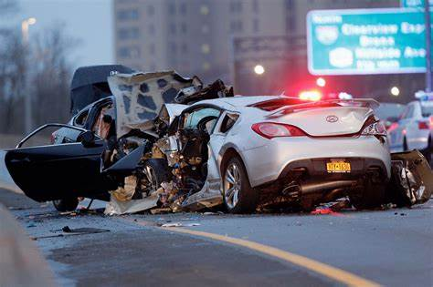
USA TRAFFIC ACCIDENT ANALYSIS
POWER BI PROJECT
BY ELMA FORTUNATE PHIRI
©FortunateCreations

Slide 2
Introduction
This project aims to analyze traffic accidents data to identify patterns related to road conditions, weather, and time of the day and visualize accidents hotspots and contributing factors
It aims to analyze the provided dataset to discover insights that can be visually expressed through the data
Data Source
US Accidents dataset(February 2016 to March 2023)
©FortunateCreations

Slide 3
Dataset Description
US Accidents dataset
This is a countrywide car accident dataset that covers 49 states of the USA.
The accident data were collected from February 2016 to March 2023, using multiple APIs that provide streaming traffic incident (or event) data.
This dataset consists of 45 columns
©FortunateCreations

Slide 4
Objectives
Identify 5 states have the highest number of accidents?
Clean and organize the data to ensure consistency and integrity of information.
Conduct exploratory data analysis to identify patterns, trends, and potential anomalies.
To determine the time of day with the most frequent accidents
Identify the days of the week with the most accidents
Identify the month have the most accidents?
Analyze the year-over-year trend in accidents
©FortunateCreations

Slide 5
Overview
Data Loading
Data Transformation
Time Series Analysis
Trend Analysis
Dashboard
Summary and Key Insights
Reference and Acknowledgements
©FortunateCreations

Slide 6
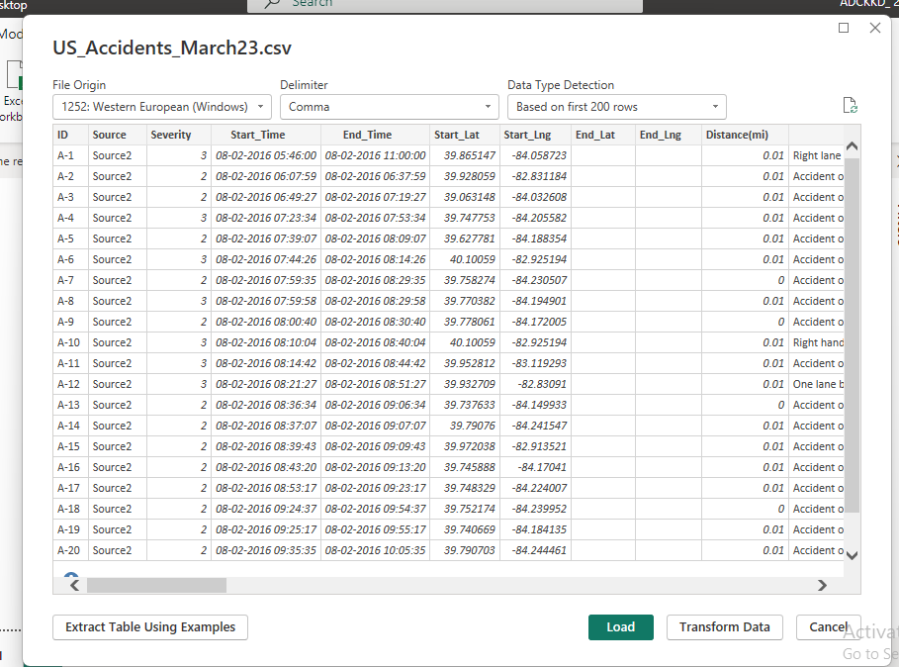
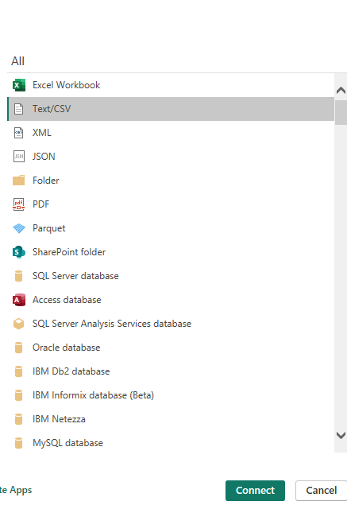
Data Loading
©FortunateCreations

Slide 7
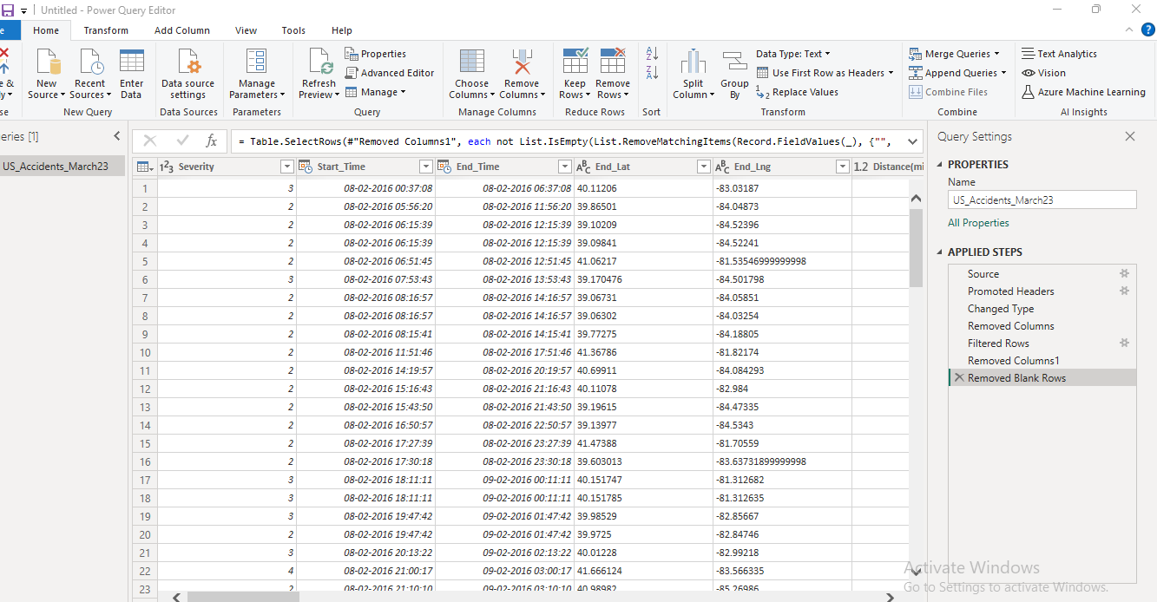
Data Transformation
Filtered Rows
Removed unnecessary Columns
Changed Data type of some of the columns
Removed Blank Rows
©FortunateCreations

Slide 8
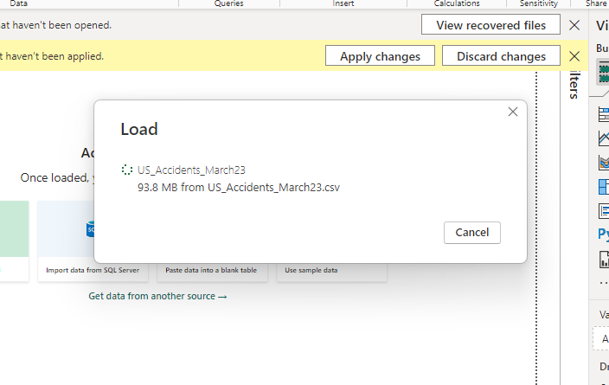
Loading transformed data
©FortunateCreations

Slide 9
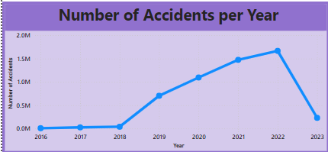
Time Series Analysis
Analyzed the number of accidents over time
Chart Type: Line Chart
Conclusion:
The year 2022 had the highest number of accidents
From 2018 to 2022 there has been an exponential increase in the number of accidents in USA
The occurrence of accidents decreases significantly in 2023, likely due to data availability only until March 2023.
©FortunateCreations

Slide 10
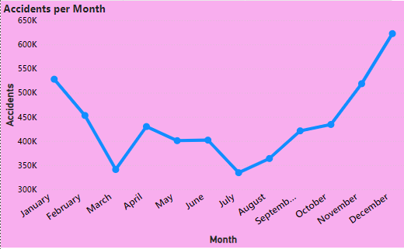
Analyzed the number of accidents monthly
Chart Type: Line Chart
Conclusion:
From the graph, most accidents occurred in the month of December with 62K total accidents followed by January with 52.8 K accidents. This may have been caused by the festive season
©FortunateCreations

Slide 11
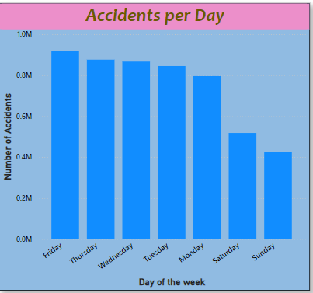
Analyzed the number of accidents daily
Chart Type: Column Chart
Conclusion:
From the graph, 91.9K accidents occurred on Friday followed by Thursday with 87.6K accidents
©FortunateCreations

Slide 12
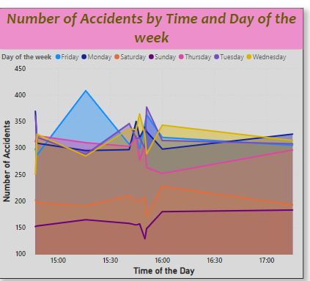
Time of day with the most frequent accidents
Chart Type: Area Chart
Conclusion:
From the graph, the time of the day with the most frequent accidents is between 15:15 and 16:00
©FortunateCreations

Slide 13
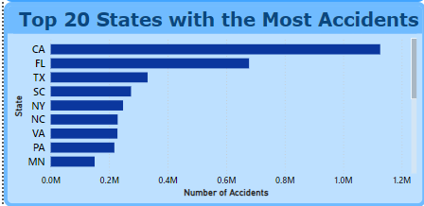
Trend Analysis
Chart Type: Bar Chart
Conclusion:
The top 3 states with most accidents are CA with 1.12M accidents followed by Florida with 67.7K accidents and Texas with 33K accidents
©FortunateCreations

Slide 14
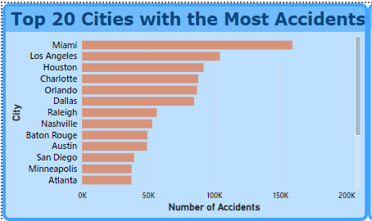
Cities with the most Accidents
Chart Type: Bar Chart
Conclusion:
The top 5 cities with most accidents are Miami with 159K accidents, Los Angeles with 104K accidents, Houston with 92K accidents, Charlotte with 88K accidents and Orlando with 87K accidents
©FortunateCreations

Slide 15
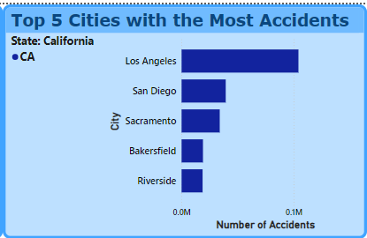
Top 5 Cities with the most accidents in California
Chart Type: Bar Chart
Conclusion:
From the graph, Los Angeles has the most accidents - 104K followed by San Diego with 39K accidents,
©FortunateCreations

Slide 16
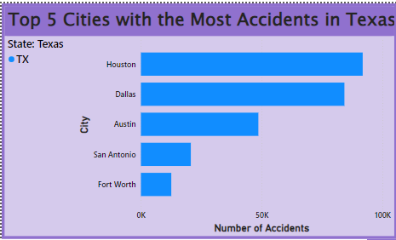
Top 5 Cities with the most accidents in Texas
Chart Type: Bar Chart
Conclusion:
From the graph, Houston has the most accidents - 92K followed by Dallas with 84K accidents,
©FortunateCreations

Slide 17
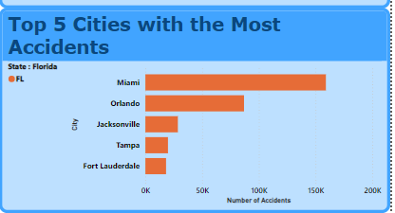
Top 5 Cities with the most accidents in Florida
Chart Type: Bar Chart
Conclusion:
From the graph, Miami has the most accidents - 159K followed by Orlando with 87K accidents,
©FortunateCreations

Slide 18
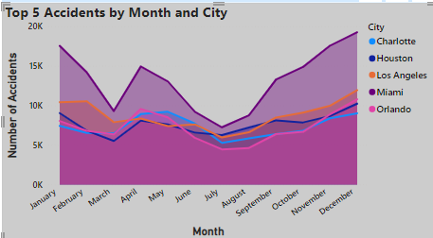
Top 5 Accidents by Month and City
Chart Type: Area Chart
Conclusion:
From the graph, most accidents occurred in December. Miami has 19.2K accidents, followed by Los Angeles with 11.9K accidents
©FortunateCreations

Slide 19
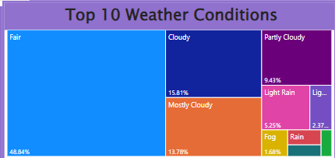
Distribution of Weather Conditions
Chart Type: Tree Map
Conclusion:
Most accidents occurred in fair conditions – 48.84%, Cloudy conditions – 15.1% and Mostly Cloudy conditions – 13.78%
©FortunateCreations

Slide 20
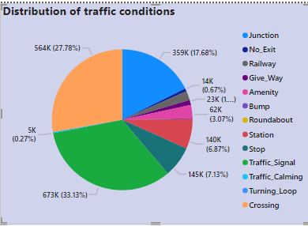
Distribution of Traffic Conditions
Chart Type: Pie Chart
Conclusion:
The majority of accidents involve traffic signals, crossings, or junctions.
©FortunateCreations

Slide 21
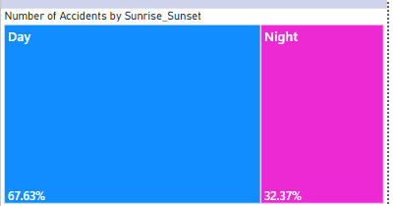
Accident occurrence by Time of the day
Chart Type: Tree Map
Conclusion:
From the graph, we can observe that a significant number of accidents occur during the day
©FortunateCreations

Slide 22
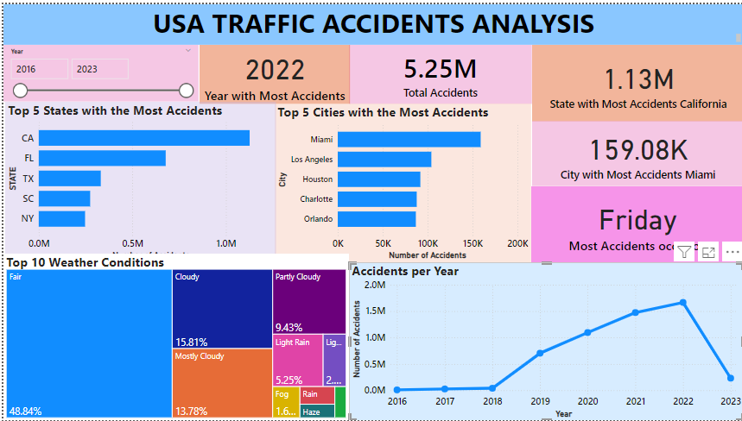
Dashboard
©FortunateCreations

Slide 23
Summary and Key Insights
The states with the highest number of accidents in the dataset are California, Florida and Texas. In California, the city with the most accidents is Los Angeles, in Texas, the city with the most accidents is Houston. In Florida, the city with the most accidents is Miami..
The five cities with the highest number of accidents in the dataset are Miami, Houston, Los Angeles, Charlotte, and Dallas.
The occurrence of accidents decreases significantly in 2023, likely due to data availability only until March 2023
A significant number of accidents occur during the day
The majority of accidents involve traffic signals, crossings, or junctions.
Majority of accidents occur under fair weather conditions
©FortunateCreations

Slide 24
REFERENCE AND ACKNOWLEDGEMENTS
•References:
US Accidents dataset(February 2016 to March 2023)
•Acknowledgements:
Many thanks to mentors, colleagues, and data providers.
©FortunateCreations

